Slide 1
Digital product design
Lecture 11: Designing Human-AI Collaboration
Alex Moehring

Slide 2
Outline
Review of automated decision making systems
Framework for human-ai collaboration
Empirical example
Implications for design of human-ai collaboration

Slide 3
Human vs algorithmic decisions

Slide 4
Comparative Advantage of Humans vs Algorithm
Algorithmic decisions
Instantaneous
Consistent
Makes good use of training data
Objective is clear
Human decisions
Able to use additional data
More explainable?

Slide 5
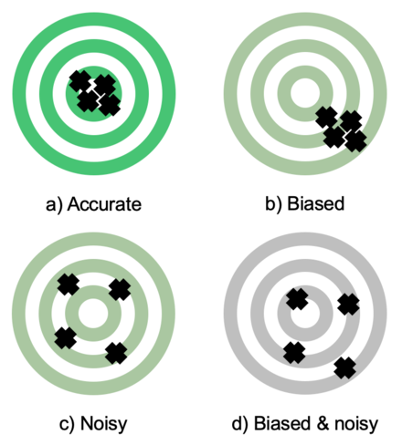
Many Well-Documented Human Prediction Errors
Representativeness
Conjunction Fallacy
Base Rate Fallacy
Confirmation Bias
Noisy Decisions
Mood, time of day, …

Slide 6
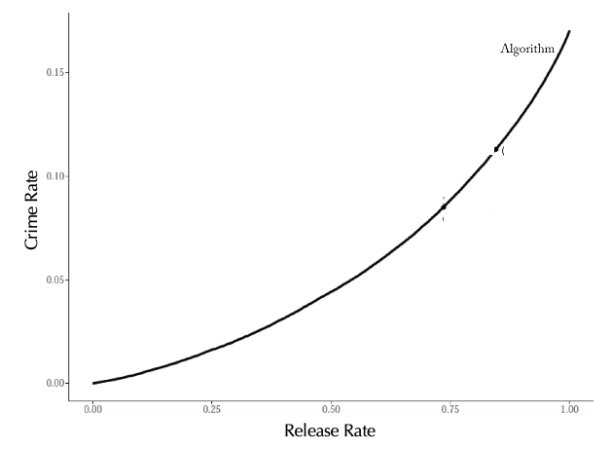
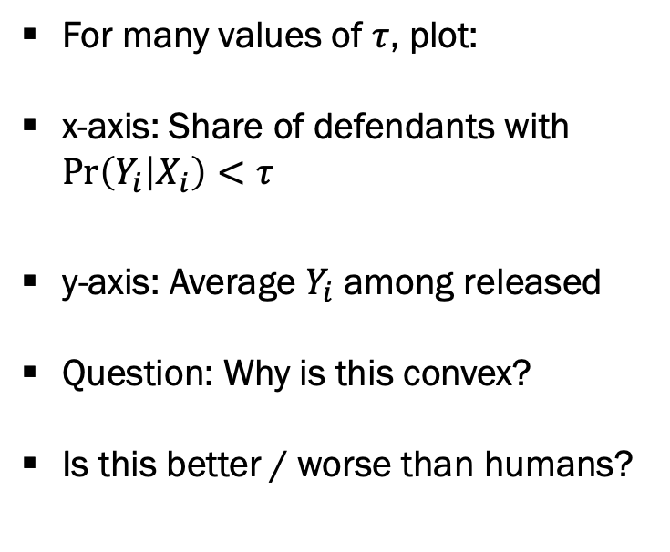
Evaluating Algorithm Decisions
For many values of $τ$, plot:
x-axis: Share of defendants with $\operatorname{Pr}\left(Y_{i} | X_{i}\right)<τ$
y-axis: Average $Y_{i}$ among released
Question: Why is this convex?
Is this better / worse than humans?
Source: Kleinberg et al (2018)

Slide 7
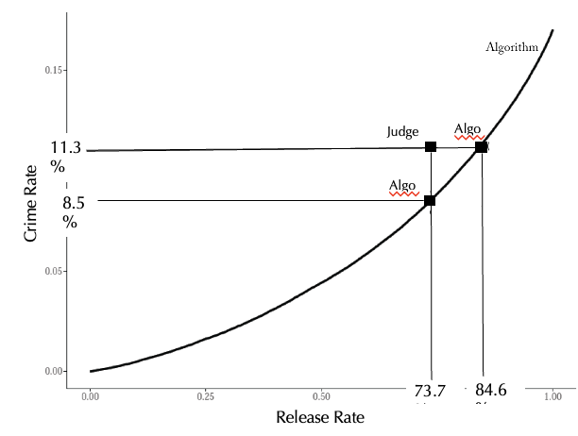
Evaluating Algorithm Decisions, Continued
Add performance of human judge
Keep jail population fixed
Reduce crime rate by 24%
Keep crime rate fixed, reduce jail population by 40%!
Algorithm seems to improve on human decisions!
Source: Kleinberg et al (2018)

Slide 8
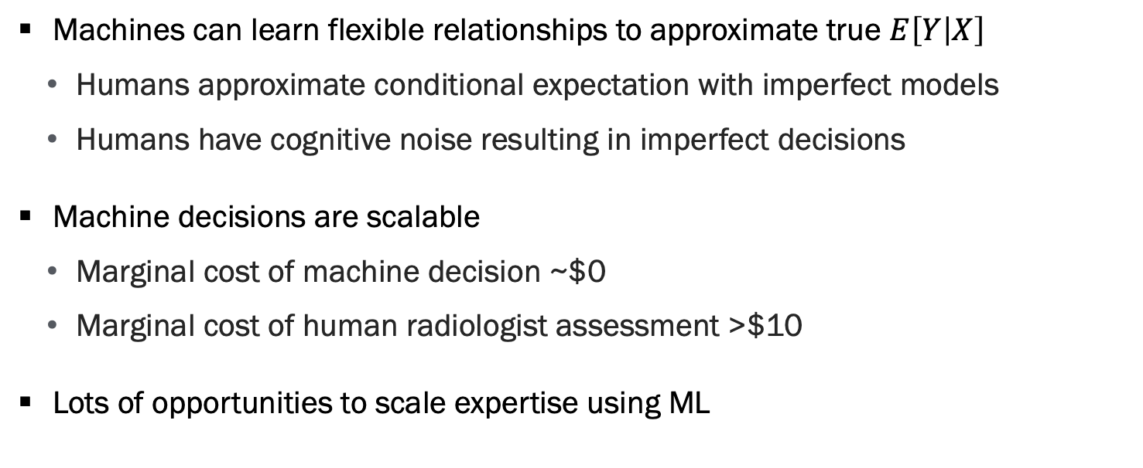
Promise of Algorithmic Decision Making
Machines can learn flexible relationships to approximate true $E\left[Y | X\right]$
Humans approximate conditional expectation with imperfect models
Humans have cognitive noise resulting in imperfect decisions
Machine decisions are scalable
Marginal cost of machine decision ~$0
Marginal cost of human radiologist assessment >$10
Lots of opportunities to scale expertise using ML

Slide 9
Humans + algorithmic decisions

Slide 10
Motivation for Human-in-the-Loop Systems
Situations where we want final decision made by human
Mitigate legal liability
Regulatory necessity
Customers prefer human interaction
Situations where humans have valuable information
Doctor’s conversation with patients
Experienced manager has intuition about demand conditions
…

Slide 11
Motivation for Human-in-the-Loop Systems, Continued
In such situations, human decisions are still often biased + noisy
Today we ask if we can improve human decisions by giving them access to algorithmic recommendations / predictions
Hope is we can get the best of both worlds
Concern is humans will mis-use the algorithm

Slide 12
Framework for Human-AI Collaboration
Focus on binary classification problems
Examples:
Medical testing
Will defendant reoffend
Will applicant repay loan
HR recruiter screens (will manager hire)

Slide 13
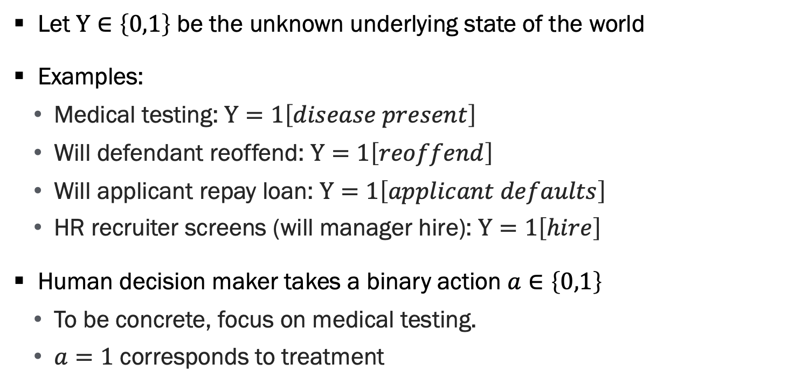
Framework for Human-AI Collaboration, Part 2
Let $Y∈\left\{0,1\right\}$ be the unknown underlying state of the world
Examples:
Medical testing: $Y=1\left[disease present\right]$
Will defendant reoffend: $Y=1\left[reoffend\right]$
Will applicant repay loan: $Y=1\left[applicant defaults\right]$
HR recruiter screens (will manager hire): $Y=1\left[hire\right]$
Human decision maker takes a binary action $a∈\left\{0,1\right\}$
To be concrete, focus on medical testing.
$a=1$ corresponds to treatment

Slide 14
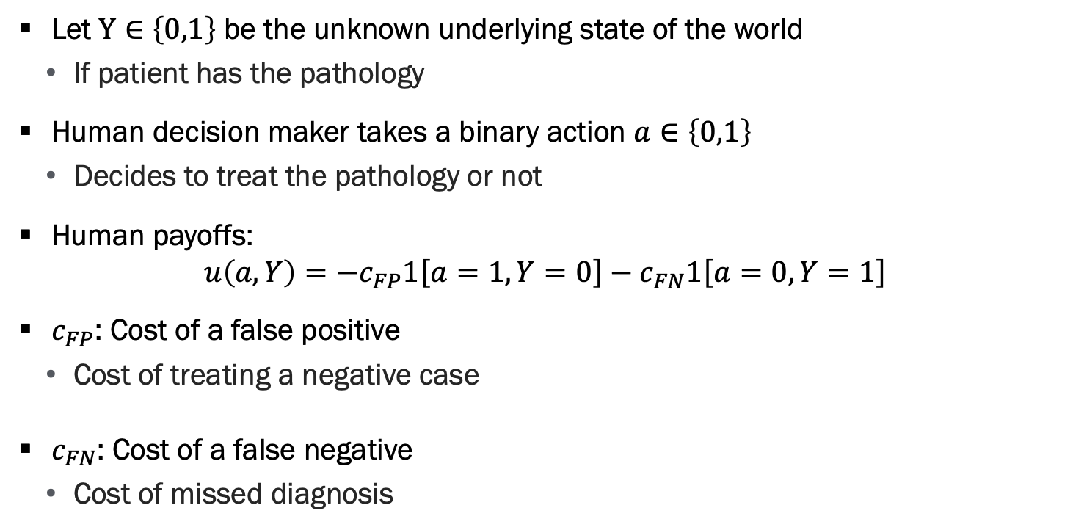
Framework for Human-AI Collaboration, Part 3
Let $Y∈\left\{0,1\right\}$ be the unknown underlying state of the world
If patient has the pathology
Human decision maker takes a binary action $a∈\left\{0,1\right\}$
Decides to treat the pathology or not
Human payoffs:
$$u\left(a,Y\right)=−c_{FP}1\left[a=1,Y=0\right]−c_{FN}1\left[a=0,Y=1\right]$$
$c_{FP}$: Cost of a false positive
Cost of treating a negative case
$c_{FN}$: Cost of a false negative
Cost of missed diagnosis

Slide 15
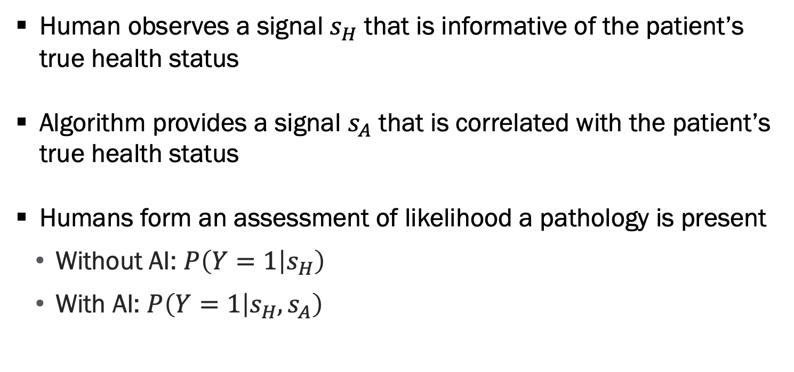
Information Structure
Human observes a signal $s_{H}$ that is informative of the patient’s true health status
Algorithm provides a signal $s_{A}$ that is correlated with the patient’s true health status
Humans form an assessment of likelihood a pathology is present
Without AI: $P\left(Y=1 | s_{H}\right)$
With AI: $P\left(Y=1 | s_{H},s_{A}\right)$

Slide 16
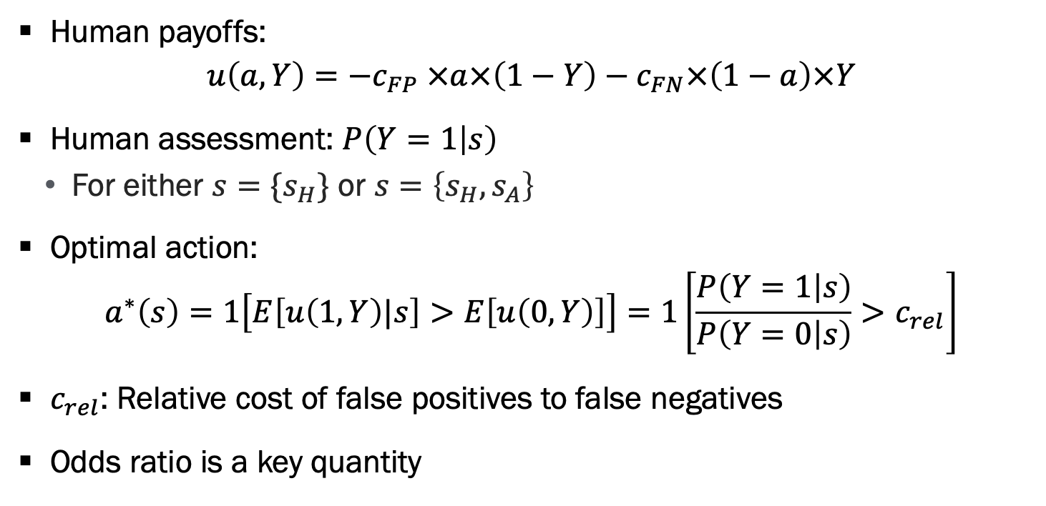
Optimal Action
Human payoffs:
$$u\left(a,Y\right)=−c_{FP} ×a×\left(1−Y\right)−c_{FN}×\left(1−a\right)×Y$$
Human assessment: $P\left(Y=1 | s\right)$
For either $s=\{s_{H}\}$ or $s=\left\{s_{H},s_{A}\right\}$
Optimal action:
$$a^{∗}\left(s\right)=1\left[E\left[u\left(1,Y\right)|s\right]>E\left[u\left(0,Y\right)\right]\right]=1\left[\frac{P\left(Y=1 | s\right)}{P\left(Y=0 | s\right)}>c_{rel}\right]$$
$c_{rel}$: Relative cost of false positives to false negatives
Odds ratio is a key quantity

Slide 17
Key Questions
How does algorithm information impact quality of assessments?
How does additional private info impact quality of assessments?
How do humans update beliefs in response to new information?
Ideal setting: An A/B test where we randomize if a case is assessed with or without algorithm assistance

Slide 18
Empirical example: Radiology

Slide 19
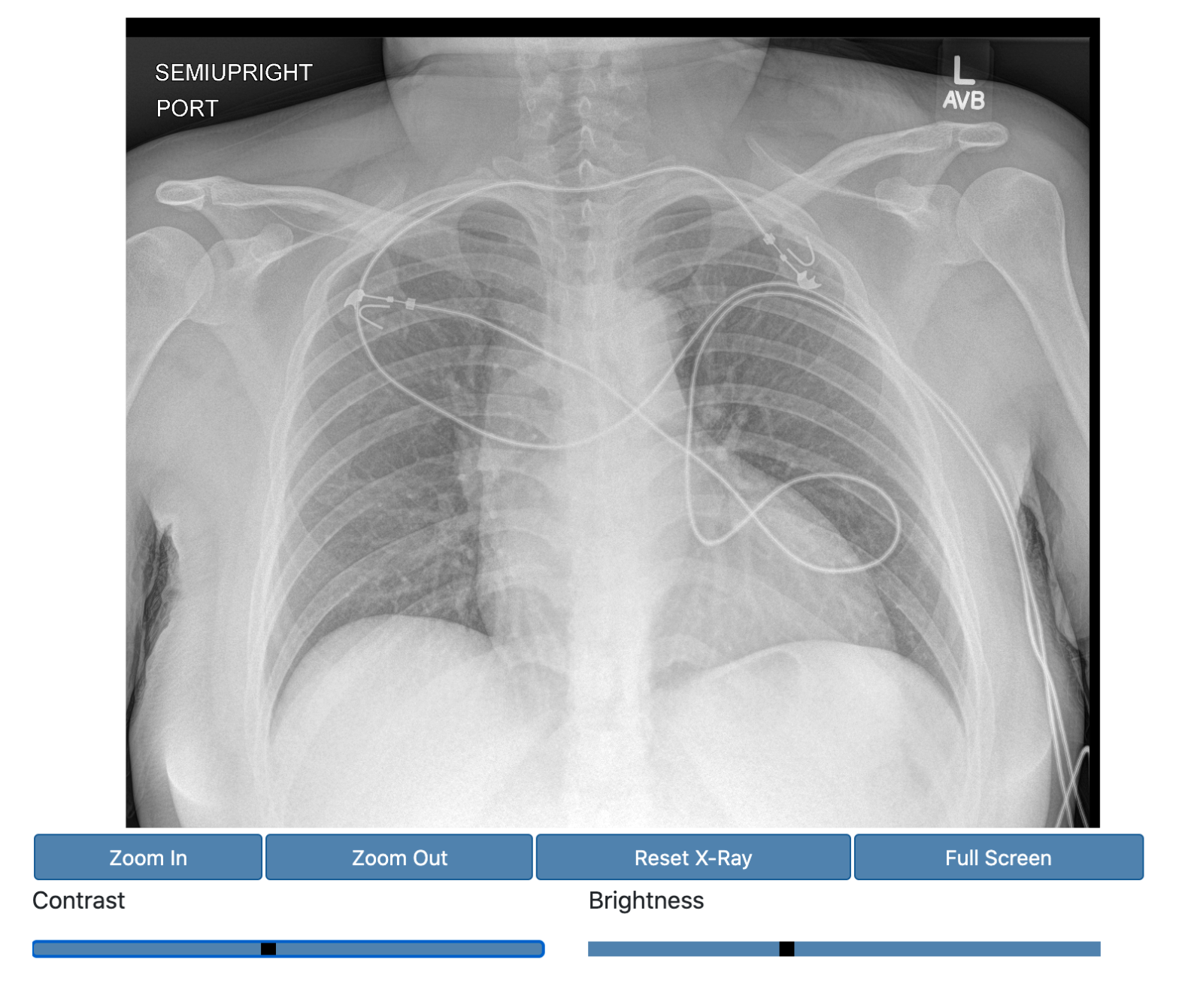
Our Experiment
Recruit professional radiologists to read actual chest x-rays
Manipulate their information environment

Slide 20
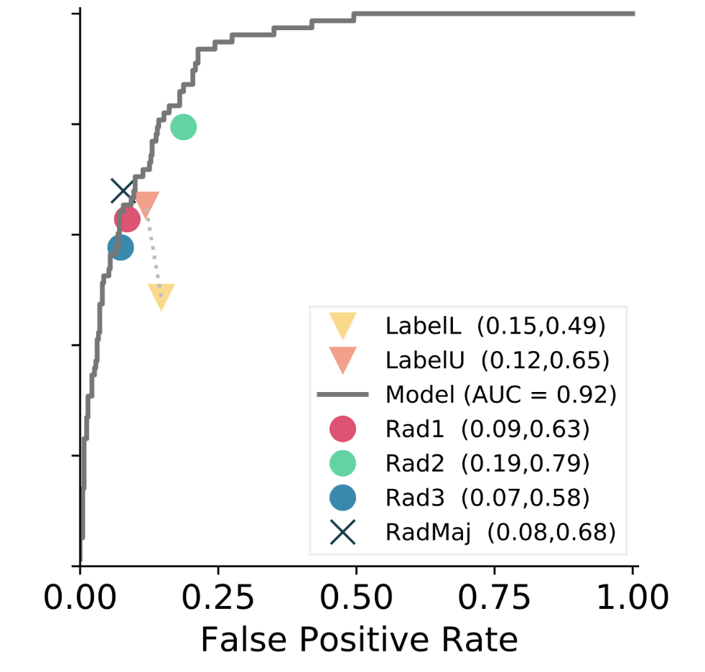
Treatment 1: AI Algorithm
Provide CheXperT algorithm on subset of assessments
Convolutional neural net trained on >200,000 x-rays with labels
Performance matches that of Stanford radiologists

Slide 21
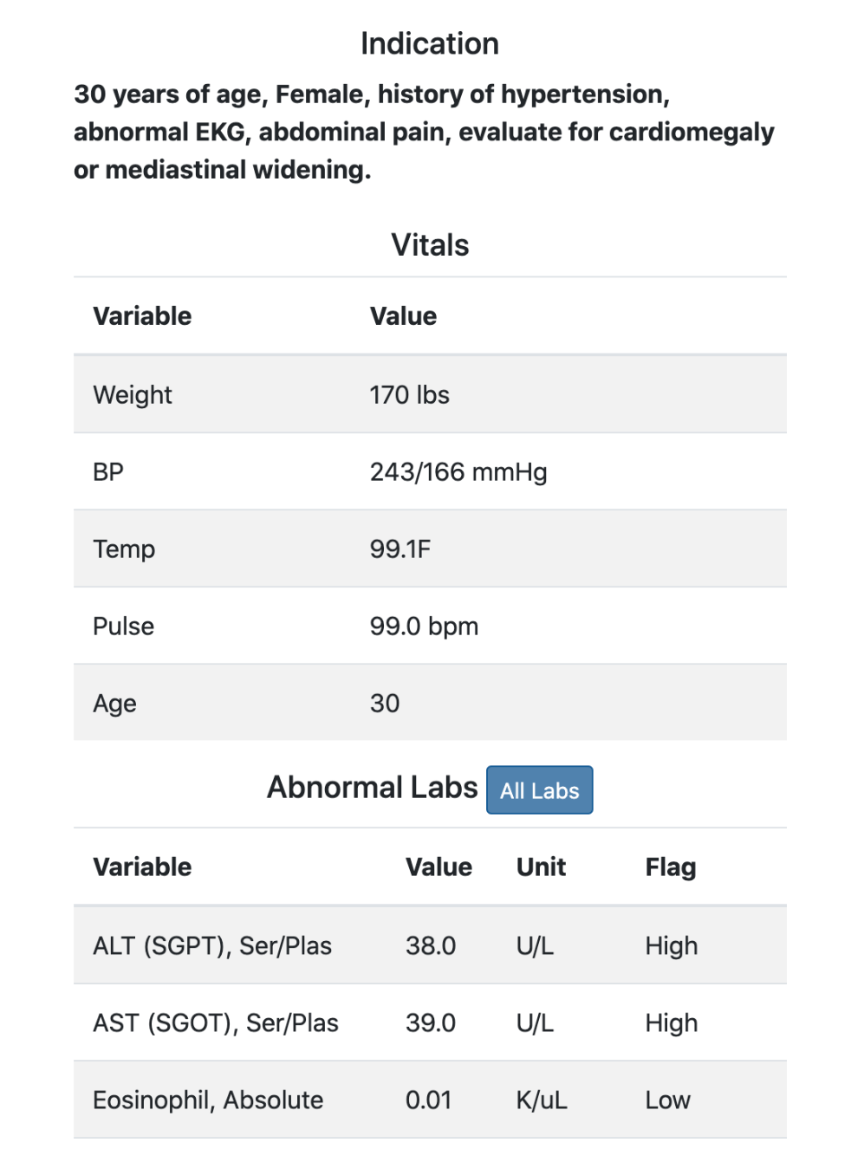
Treatment 2: Clinical History

Slide 22
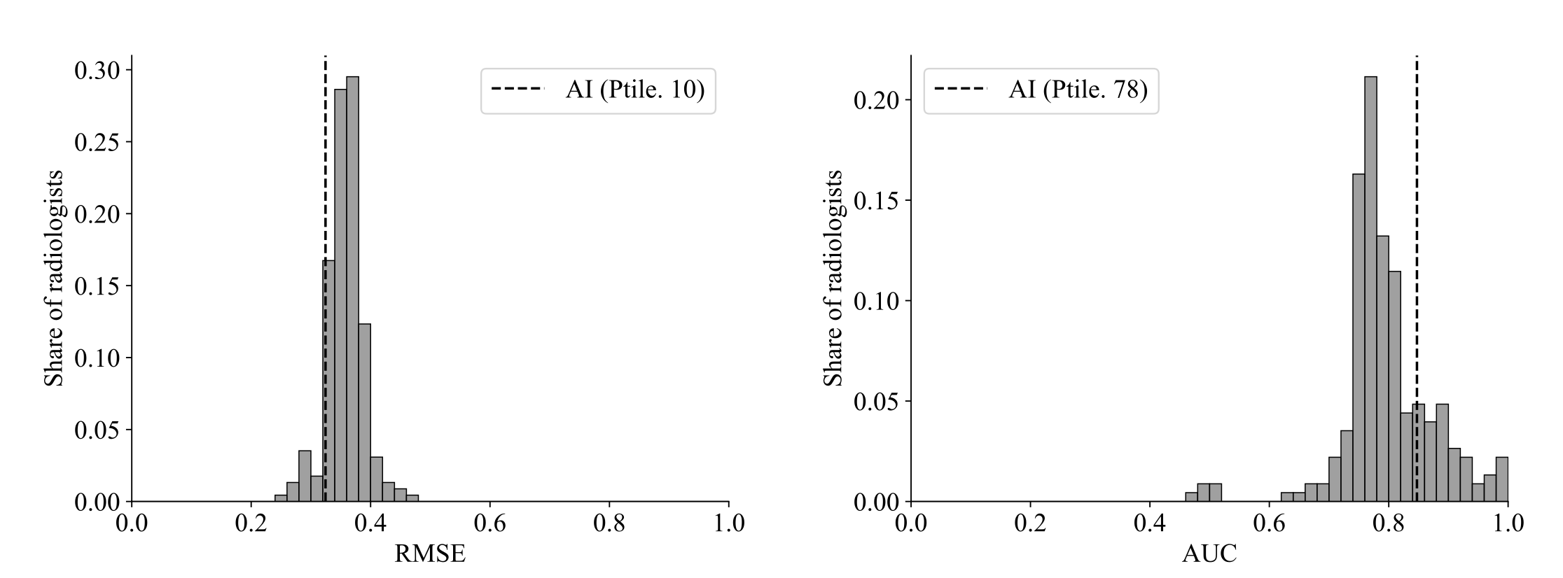
AI Assessment More Accurate than Majority of Radiologists

Slide 23
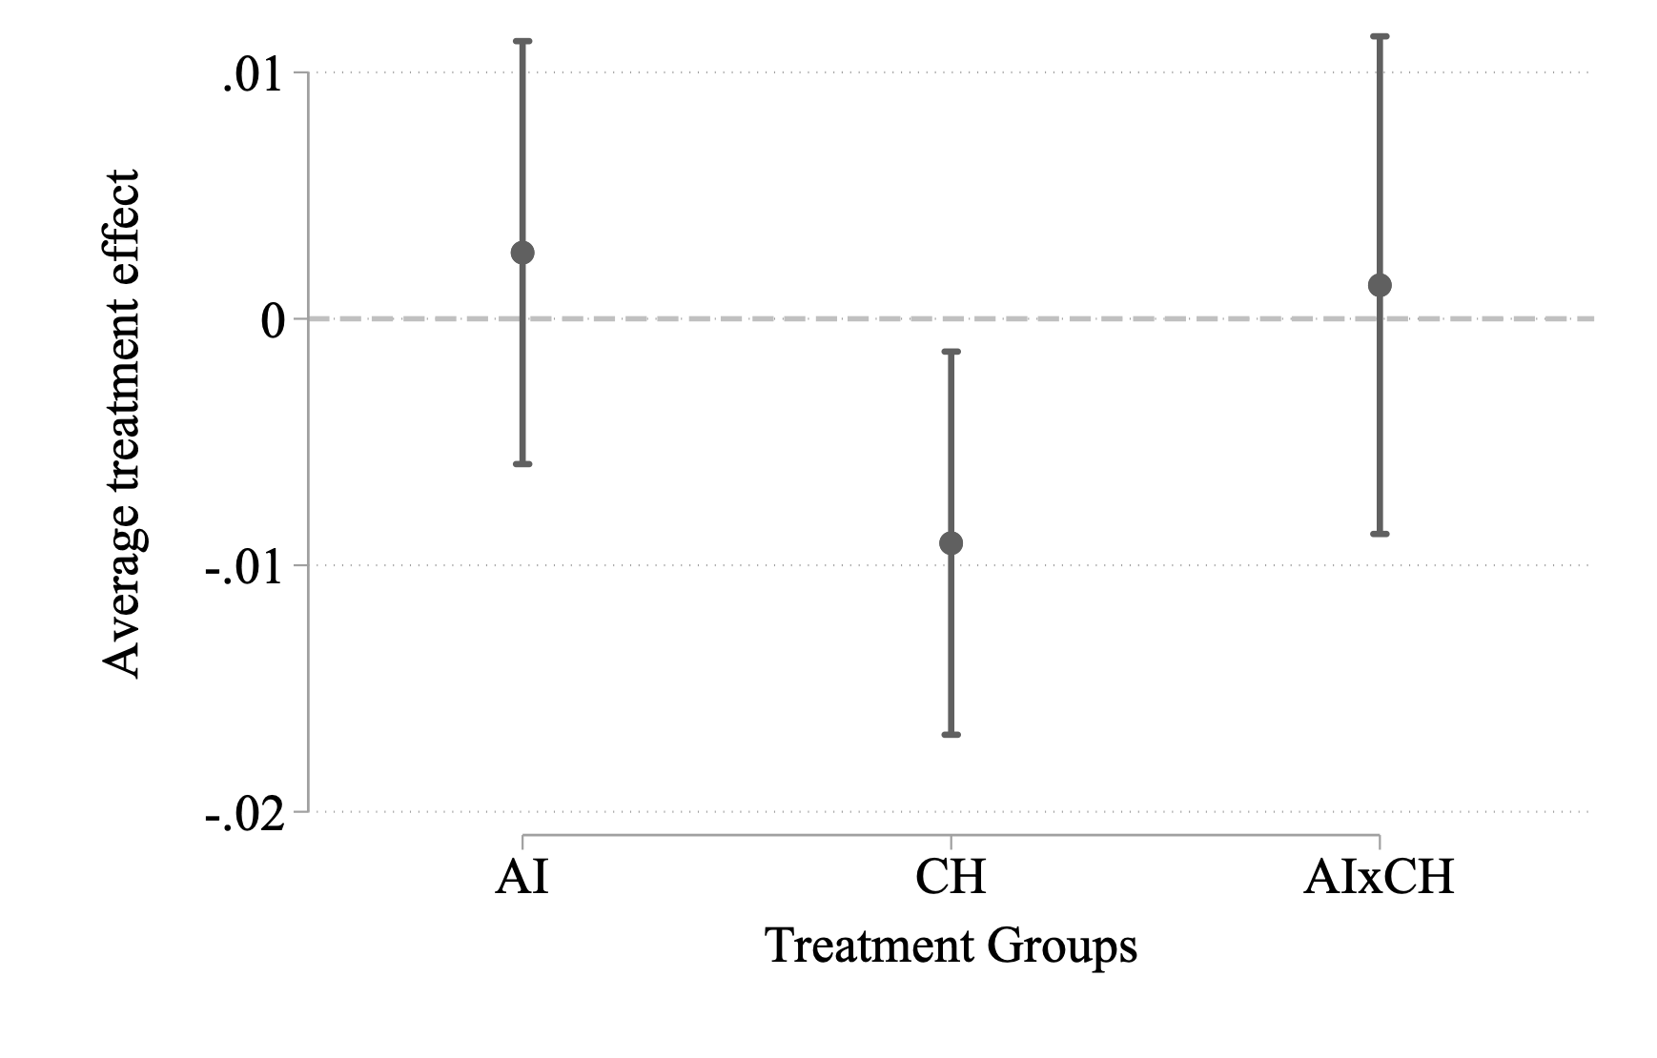
Treatment Effects – Deviation from Diagnostic Standard
Notes:
Write regression on the board

Slide 24
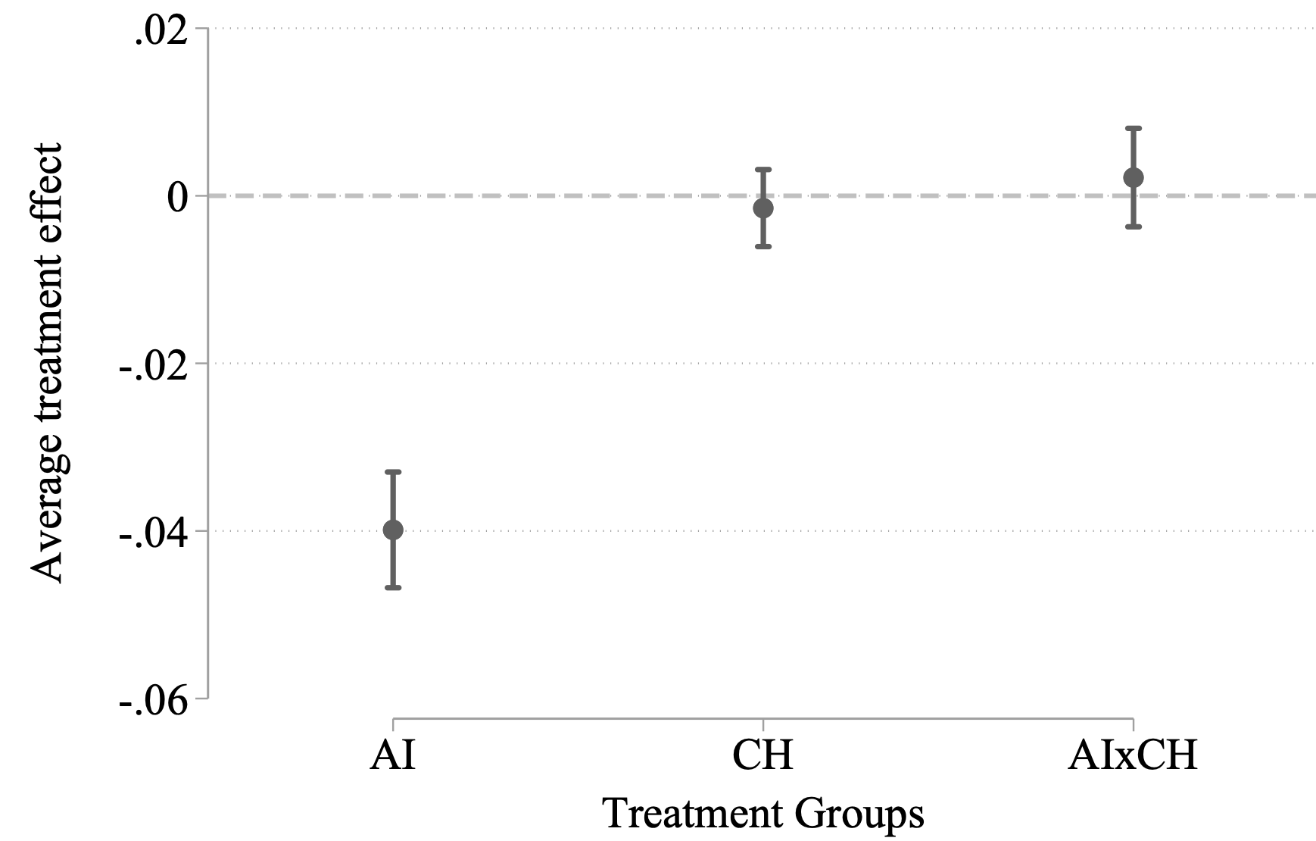
Treatment Effects – Deviation from AI
Notes:
Write regression on the board

Slide 25
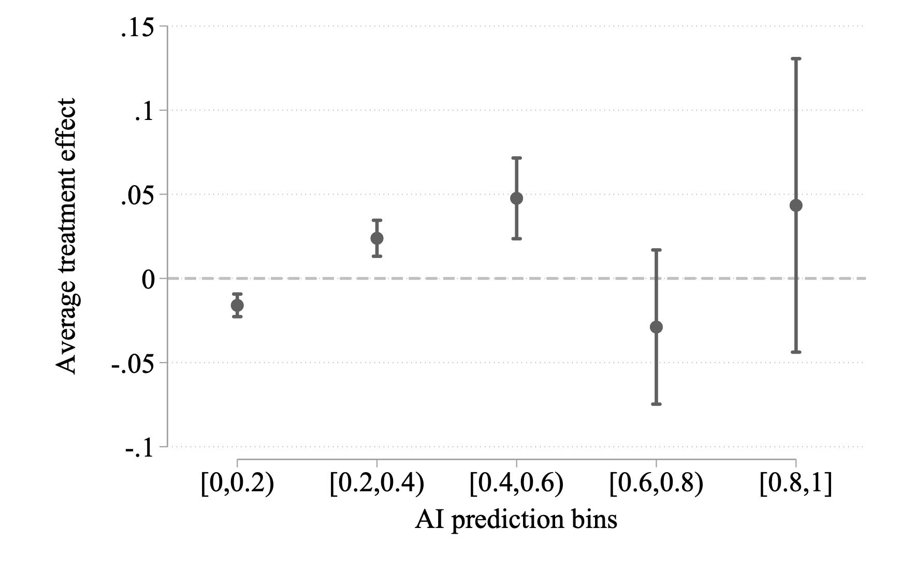
Heterogeneous Treatment Effects – Deviation from DS
Notes:
Write regression on the board

Slide 26
Takeaways from Radiology Example
Human’s private information is valuable
Want to incorporate human information in decisions
Human decisions do not get more accurate with AI
Because of heterogeneous effect
Human assessments worsening with AI implies they are not behaving optimally
What mistakes are humans making?

Slide 27
Biased belief updating

Slide 28
Bayes Rule Revisited
Remember Bayes rule tells us how to update beliefs given new information
Re-writing definition of conditional probability
Deviations from Bayes rule suggests humans make an error
Next we try to unpack what mistakes humans are making, and what can be done to fix this

Slide 29
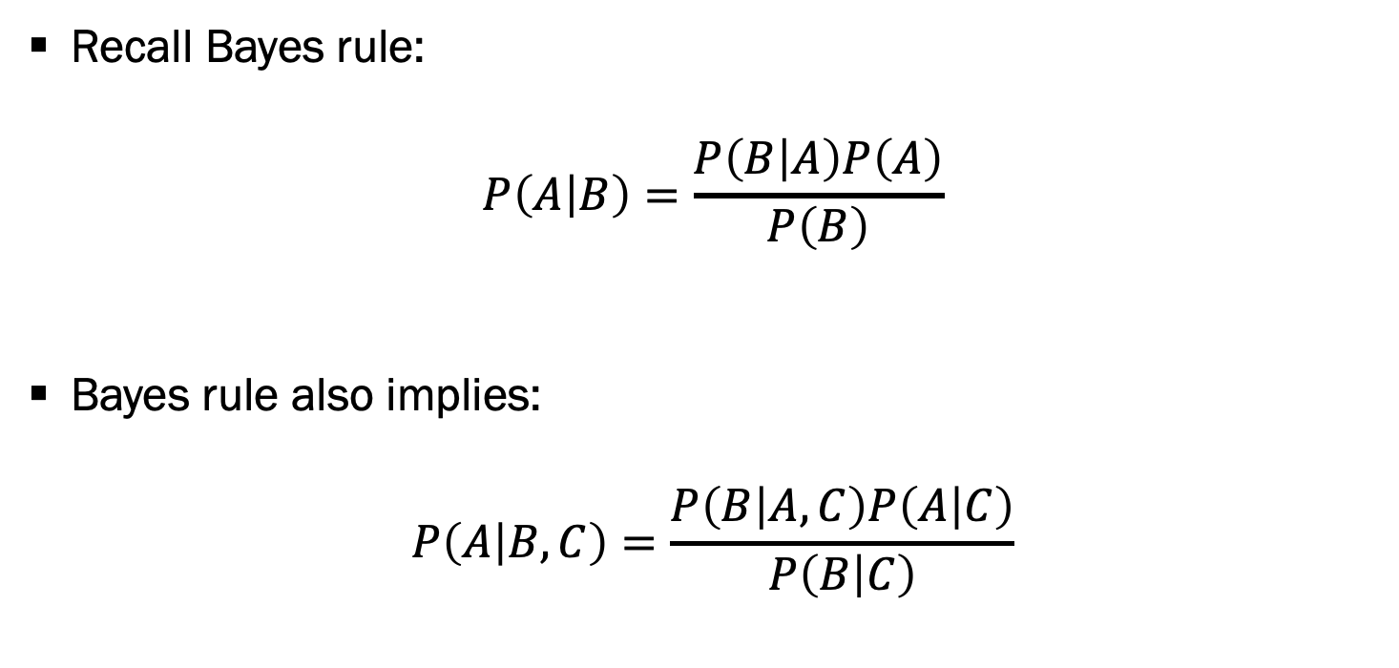
Bayes Rule Revisited, Part 2
Recall Bayes rule:
$$P\left(A | B\right)=\frac{P\left(B | A\right)P\left(A\right)}{P\left(B\right)}$$
Bayes rule also implies:
$$P\left(A | B,C\right)=\frac{P\left(B | A,C\right)P\left(A | C\right)}{P\left(B | C\right)}$$

Slide 30
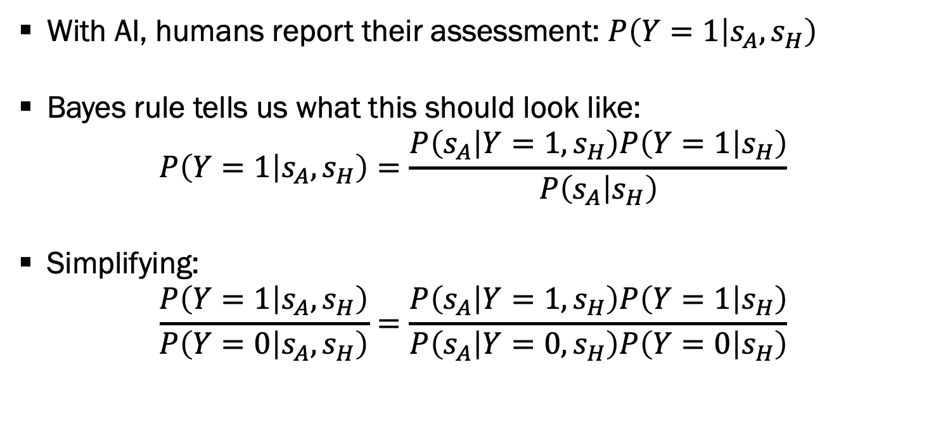
Bayes Rule Revisited, Part 3
With AI, humans report their assessment: $P\left(Y=1 | s_{A},s_{H}\right)$
Bayes rule tells us what this should look like:
$$P\left(Y=1 | s_{A},s_{H}\right)=\frac{P\left(s_{A} | Y=1,s_{H}\right)P\left(Y=1 | s_{H}\right)}{P\left(s_{A} | s_{H}\right)}$$
Simplifying:
$$\frac{P\left(Y=1 | s_{A},s_{H}\right)}{P\left(Y=0 | s_{A},s_{H}\right)}=\frac{P\left(s_{A} | Y=1,s_{H}\right)P\left(Y=1 | s_{H}\right)}{P\left(s_{A} | Y=0,s_{H}\right)P\left(Y=0 | s_{H}\right)}$$

Slide 31
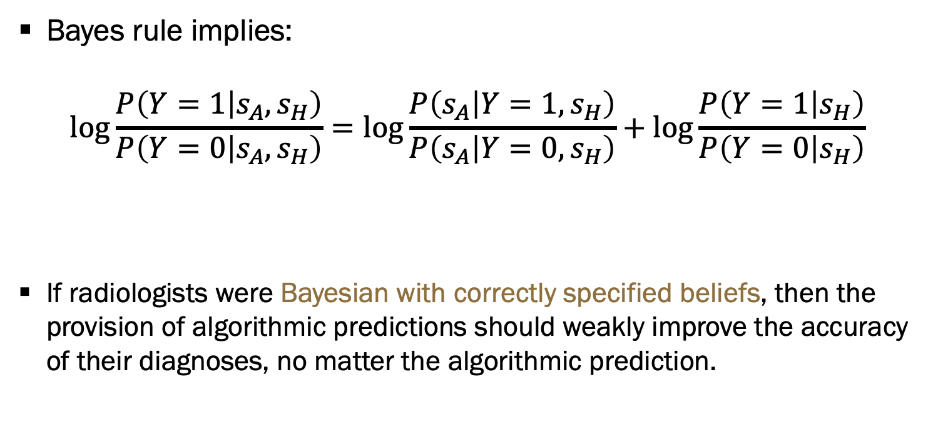
Modeling Human Belief Updating
Bayes rule implies:
$$\log{\frac{P\left(Y=1 | s_{A},s_{H}\right)}{P\left(Y=0 | s_{A},s_{H}\right)}}=\log{\frac{P\left(s_{A} | Y=1,s_{H}\right)}{P\left(s_{A} | Y=0,s_{H}\right)}}+\log{\frac{P\left(Y=1 | s_{H}\right)}{P\left(Y=0 | s_{H}\right)}}$$
If radiologists were Bayesian with correctly specified beliefs, then the provision of algorithmic predictions should weakly improve the accuracy of their diagnoses, no matter the algorithmic prediction.
Posterior beliefs after seeing algorithmic predictions
Informativeness of algorithmic prediction
Prior beliefs based on own signals

Slide 32
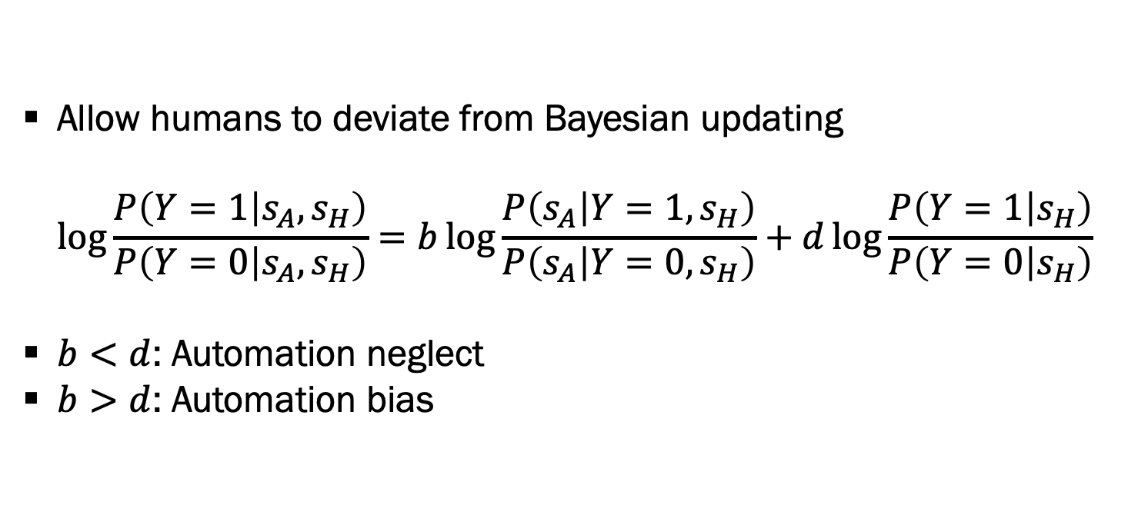
Modeling Human Belief Updating, Part 2
Allow humans to deviate from Bayesian updating
$$\log{\frac{P\left(Y=1 | s_{A},s_{H}\right)}{P\left(Y=0 | s_{A},s_{H}\right)}}=b\log{\frac{P\left(s_{A} | Y=1,s_{H}\right)}{P\left(s_{A} | Y=0,s_{H}\right)}}+d\log{\frac{P\left(Y=1 | s_{H}\right)}{P\left(Y=0 | s_{H}\right)}}$$
$b<d$: Automation neglect
$b>d$: Automation bias

Slide 33
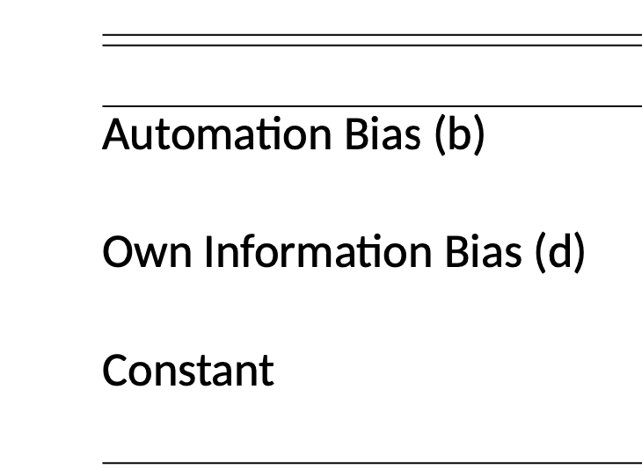
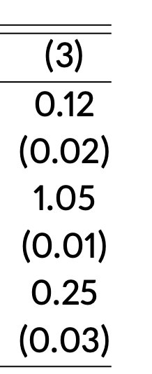
Modeling Human Belief Updating, Part 3
Find robust evidence of automation neglect
Humans underweight AI signal
I.e. humans are overconfident in their own information
How well does this fit the data?

Slide 34
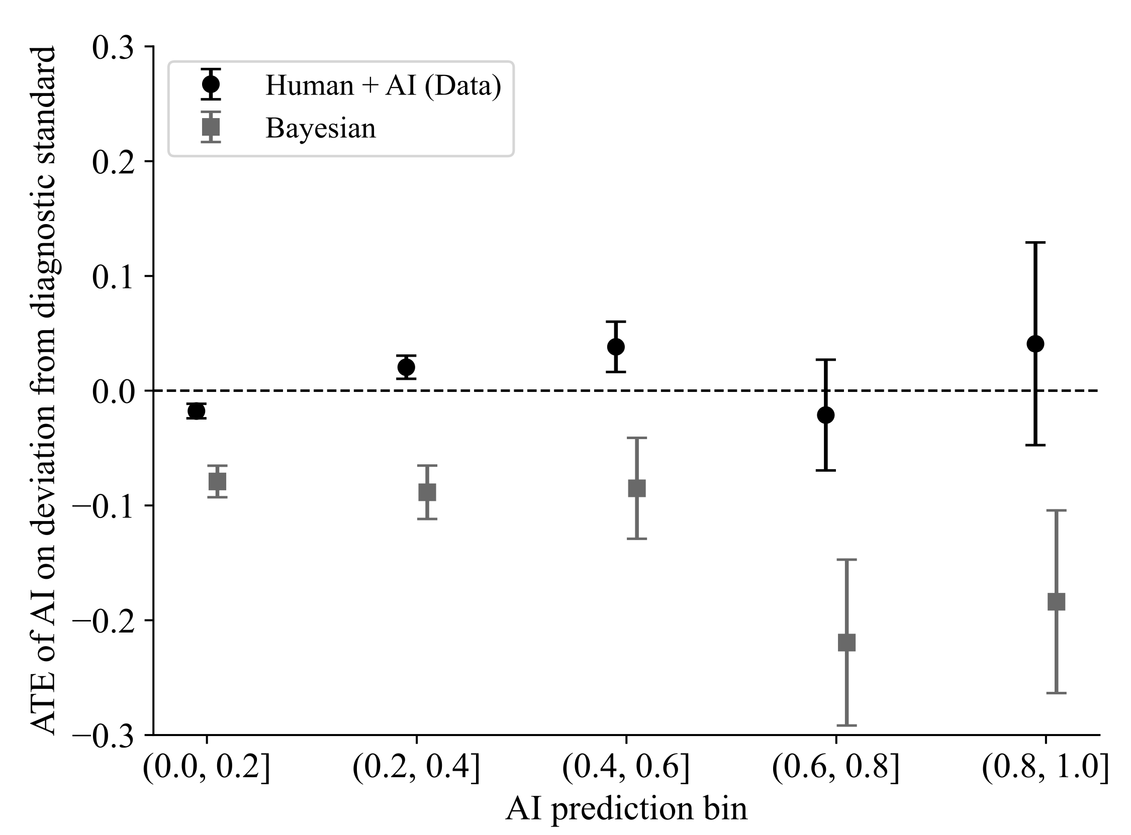
Modeling Human Belief Updating, Part 4

Slide 35
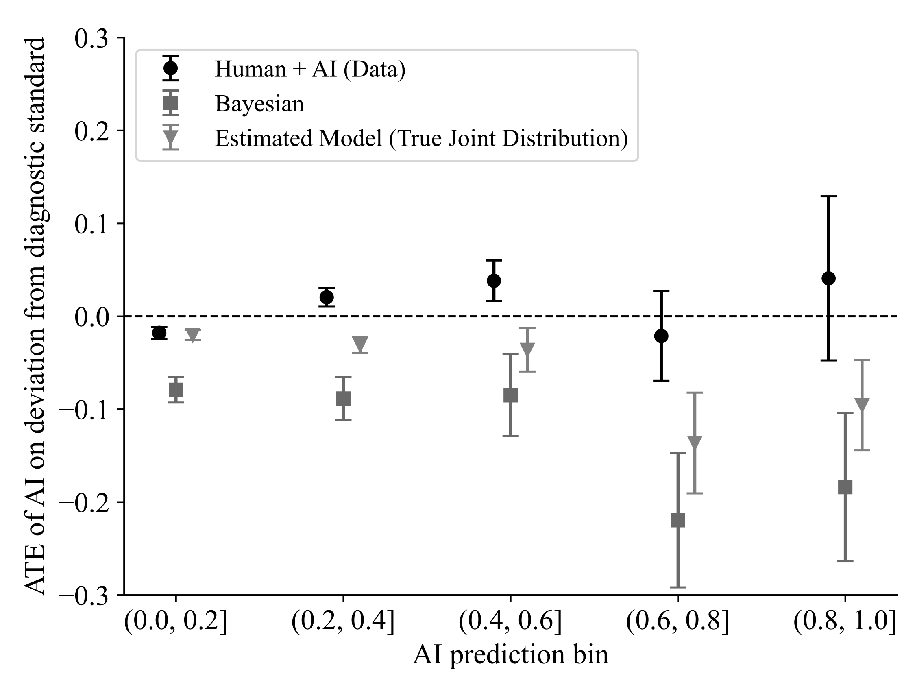
Modeling Human Belief Updating, Part 5

Slide 36
Modeling Human Belief Updating, Part 6
Automation neglect alone does not explain treatment effect patterns
With only automation neglect, humans always weakly better with AI
Signal dependence neglect explains the remaining gap

Slide 37
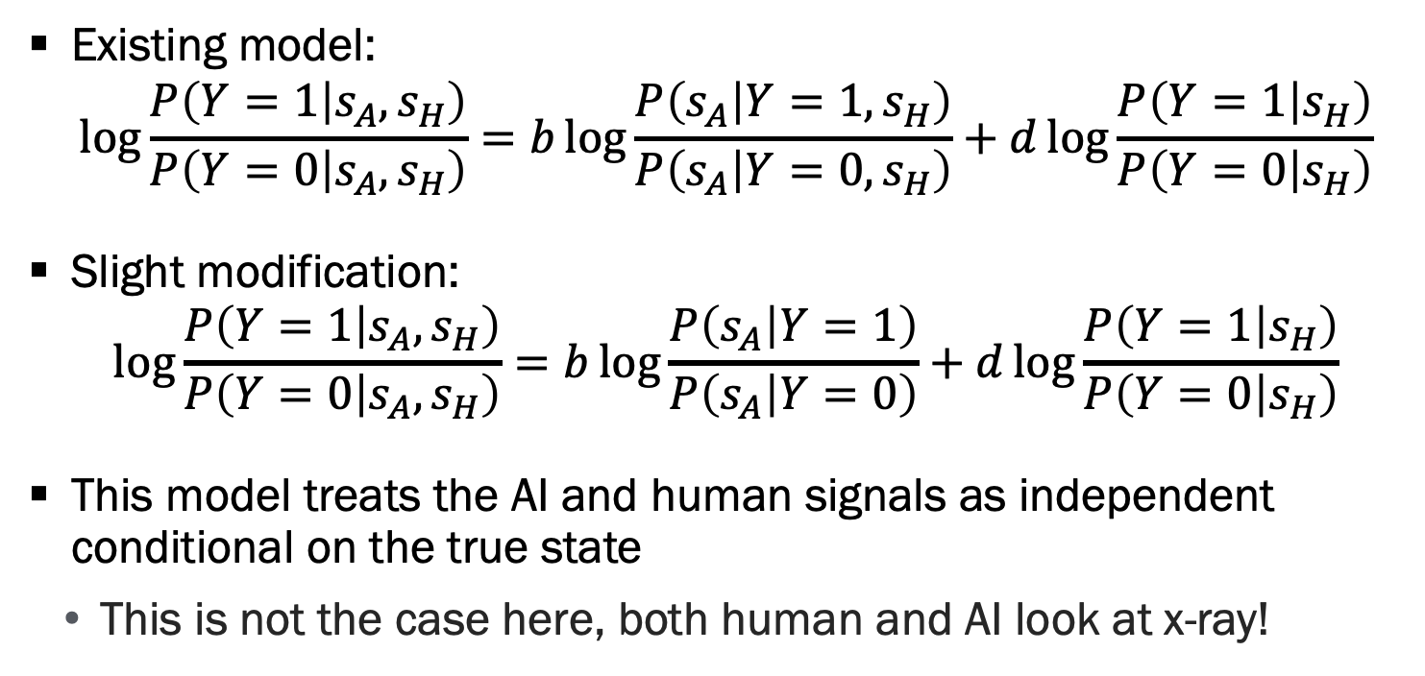
Signal Dependence Neglect
Existing model:
$$\log{\frac{P\left(Y=1 | s_{A},s_{H}\right)}{P\left(Y=0 | s_{A},s_{H}\right)}}=b\log{\frac{P\left(s_{A} | Y=1,s_{H}\right)}{P\left(s_{A} | Y=0,s_{H}\right)}}+d\log{\frac{P\left(Y=1 | s_{H}\right)}{P\left(Y=0 | s_{H}\right)}}$$
Slight modification:
$$\log{\frac{P\left(Y=1 | s_{A},s_{H}\right)}{P\left(Y=0 | s_{A},s_{H}\right)}}=b\log{\frac{P\left(s_{A} | Y=1\right)}{P\left(s_{A} | Y=0\right)}}+d\log{\frac{P\left(Y=1 | s_{H}\right)}{P\left(Y=0 | s_{H}\right)}}$$
This model treats the AI and human signals as independent conditional on the true state
This is not the case here, both human and AI look at x-ray!

Slide 38
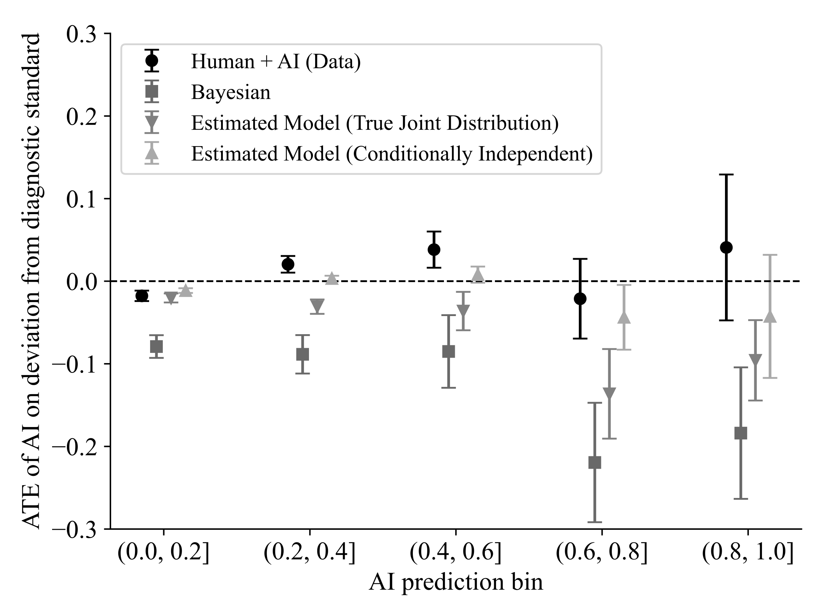
Signal Dependence Neglect, Continued

Slide 39
Takeaways, Biased Belief Updating
Humans incorrectly incorporate AI information in their assessment
Underweight the AI relative to their own information
Treat the AI as conditionally independent of their own information
Results in human assessments being worse with AI when the AI is uncertain!
These biases limit the benefit of giving humans access to AI tools
If you want human to make final decision => Design AI for humans!
Question: Is there anything else we can do?
Give the human signal to the AI algorithm as an input
Train a new algorithm to decide when to delegate to humans / AI

Slide 40
Delegation vs collaboration

Slide 41
Learning to Delegate
Question: How would you design a system to take advantage of the strengths of both humans and AI?
Hint: We can observe the AI signal for free
Our approach: Design a “delegator” that chooses whether to have a case assessed by:
Human alone
Human with access to AI
Fully automate the case

Slide 42
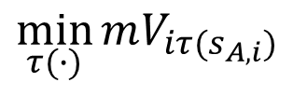
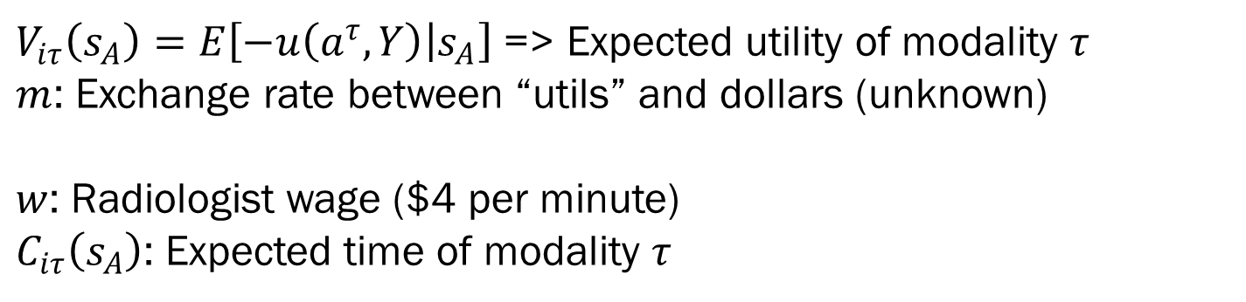

Delegation Problem
Choose the modality (H, H+AI, AI) that minimizes expected loss:
Decision Loss in $
Effort Cost in $
$$\min_{τ(∙)}{mV_{iτ(s_{A,i})}}$$
$$+ wC_{iτ_{(s_{A,i})}}$$
$V_{iτ}\left(s_{A}\right)=E\left[−u\left(a^{τ},Y\right) | s_{A}\right]$ => Expected utility of modality $τ$
$m$: Exchange rate between “utils” and dollars (unknown)
$w$: Radiologist wage ($4 per minute)
$C_{iτ}\left(s_{A}\right)$: Expected time of modality $τ$

Slide 43
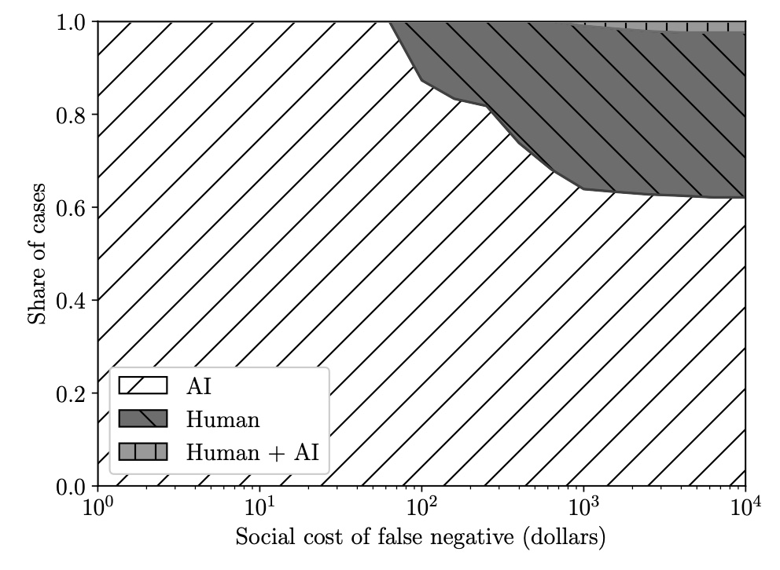
Delegation Solution – Actual Humans

Slide 44
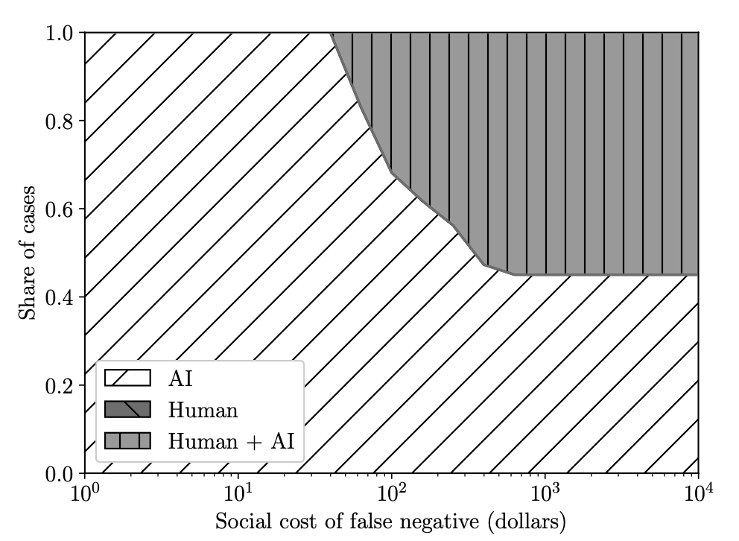
Delegation Solution – Humans w/o Biases

Slide 45
Takeaways, Delegation vs. Collaboration
Humans work alongside AI rather than collaborating with AI
This is because of humans inefficiently combine their own information with that of the AI
Substitutes on specific cases, complements overall
Question: How to approach the Bayesian solution?
Training?
AI that is designed for humans
Add human signal as an input to the algorithm

Slide 46
Project

Slide 47
Project Details
Remember: Project presentations next week
I will send out details by Saturday (waiting on distance section to specify their preferences for live vs recorded presentations)
Expect about 12 minute presentation + q&a

